Slide 1
Expert Meeting - Animal Health Law
EURL for Brucellosis 10/09/2021

Slide 2
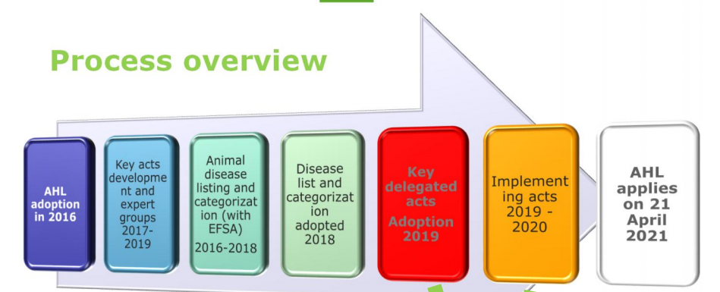
A 5-year process…
Delegated acts are supplementing Regulation (EU) 2016/429
The Commission has adopted on 17/12/2019 four (4) delegated acts:
DA on disease surveillance, eradication, disease freedom
DA on disease control measures
DA on movements of terrestrial animals
DA on traceability and movements of germinal products
Set of transitional practical elements for the use of animal health certificates during the transitional period between 21 April 2021 and October 2021, as provided for in Commission Implementing Regulations (EU) 2020/2235, 2020/2236 and 2021/403 and as amended by Commission Implementing Regulation (EU) 2021/619.

Slide 3
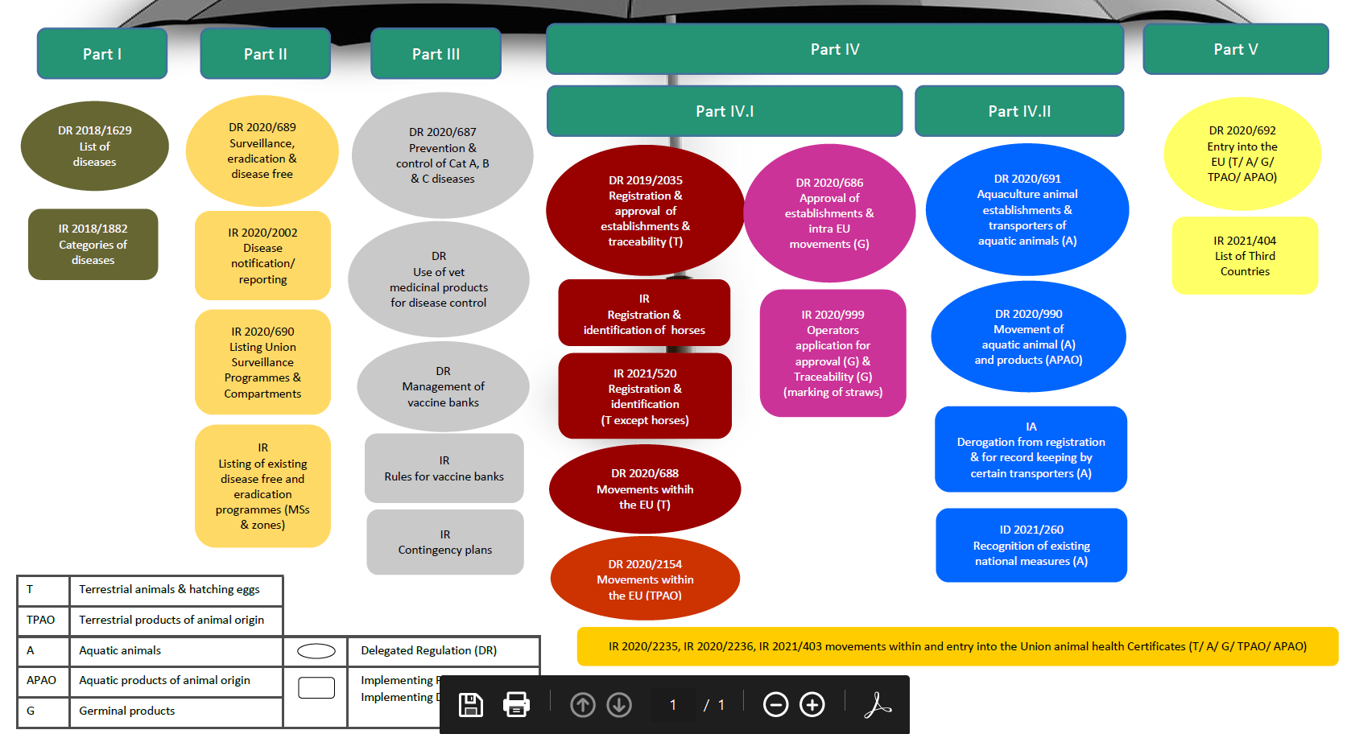
Source : https://ec.europa.eu/food/system/files/2021-04/ah_ahl_qandas_6_umbrella.pdf

Slide 4
Agenda
Presentation of AHL requirements : focus on brucellosis and ovine epididymitis (Jostein Dragset, DG SANTE)
Control of reagents / initial validation of reagents (EURL for Brucellosis) : guidelines / specifications to control reagents (antigens / ELISA kits) / initial validation steps
Presentation of updated SOPs on the EURL website
Round table / further points :
Non domestic Ruminants (Cervidae – Camelids) submitted to AHL requirements.
Reference materials (panel of reference sera ? ….)

Slide 5
Agenda
Presentation of AHL requirements : focus on brucellosis and ovine epididymitis (Jostein Dragset, DG SANTE)
Control of reagents / initial validation of reagents (EURL for Brucellosis) : guidelines / specifications to control reagents (antigens / ELISA kits) / initial validation steps
Presentation of updated SOPs on the EURL website
Round table / further points :
Non domestic Ruminants (Cervidae – Camelids) submitted to AHL requirements.
Reference materials (panel of reference sera ? ….)

Slide 6
Agenda
Presentation of AHL requirements : focus on brucellosis and ovine epididymitis (Jostein Dragset, DG SANTE)
Control of reagents / initial validation of reagents (EURL for Brucellosis) : guidelines / specifications to control reagents (antigens / ELISA kits)
Presentation of updated SOPs on the EURL website : METHODS
Round table / further points :
Non domestic Ruminants (Cervidae – Camelids) submitted to AHL requirements.
Reference materials (panel of reference sera ? ….)

Slide 7
Updated SOPs / guidelines
 |  |  | Reference material | Validated methods (with an initial validation) | Validation of methods
Infection B. melitensis, abortus, suis | BDE | Domestic ruminants (cattle, Sheep & Goat) |  | Methods -SOP RBT, CFT : website -ELISA : manufacturer instructions -Brucellergen : manufacturer instructions -Ring test (to be added) -FPA : cascade principle ? Control of batches -SOP Batch control of antigens (RB, CFT, MRT) : website -SOP Batch control of brucellin : website -SOP Batch control of ELISA kits: website | Specifications for validation of ELISA kits : website Specifications for validation of antigens (RBT, CFT, MRT) : to be added Specifications for validation of brucellin : drug regulation Specifications for validation of FPA ?

Slide 8
Updated SOPs / guidelines
Initial validation of reagents (EURL for Brucellosis) : guidelines / specifications to control reagents (antigens / ELISA kits)
ELISA kits : Brucellosis Specifications for validation of ELISA kits (i-ELISA and c-ELISA) | EURL (anses.fr)
Antigens / brucellin : to be added
Control of batches
Batch control (ELISA kits) : Bovine Brucellosis Control of indirect ELISA kits (Individual & pooled serum samples) | EURL (anses.fr)
Batch control (RB, CFT, MRT antigens) : Animal Brucellosis Control of Rose Bengal, Complement Fixation and Milk Ring-test antigens | EURL (anses.fr)
Batch control (brucellin) :

Slide 9
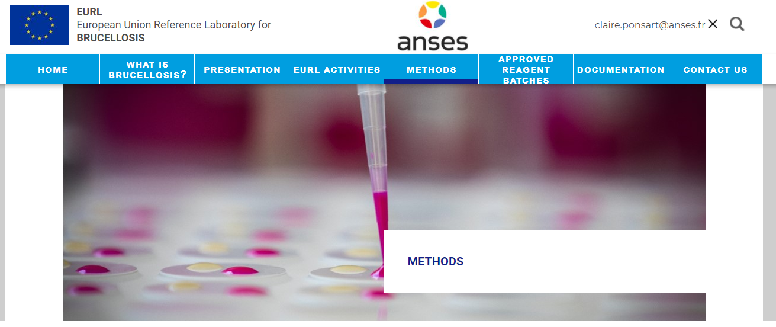
Updated SOPs / guidelines
EURL website : METHODS - open section
Méthodes | EURL (anses.fr)

Slide 10
Standards / Validated batches
EURL website : Standards (open for NRLs network)
EU standards and reference collection | EURL (anses.fr)
EURL website : Reference materials (open for NRLs network)
EU standards and reference collection | EURL (anses.fr)
EURL website : List of approved reagents (open for NRLs network)
Reagents | EURL (anses.fr)
EURL website : Certificates for approved reagents (open for NRLs network)
Approved antigens and Kit batches | EURL (anses.fr)

Slide 11
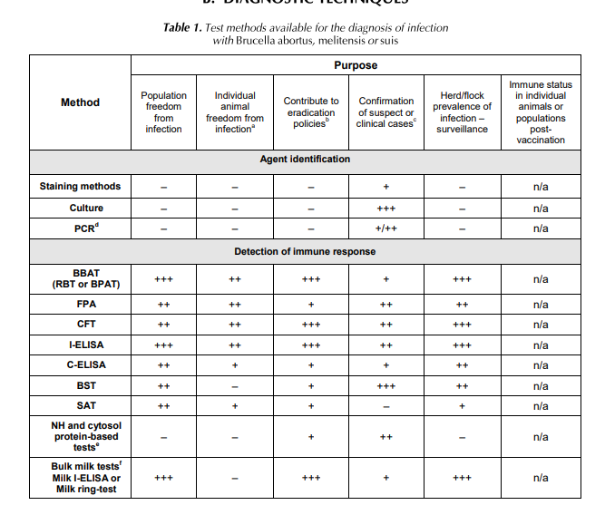
Round table / questions
Initial validation of reagents : applying new guidelines for existing kits / reagents ?
Needs for SOPs / methods : how to apply cascade principles
FPA ? Brucellin ?
Identification / typing ? Molecular tools ?
Needs for reference materials ?
Small ruminants ?
Camelids
Cervidae
Other ?

Slide 12
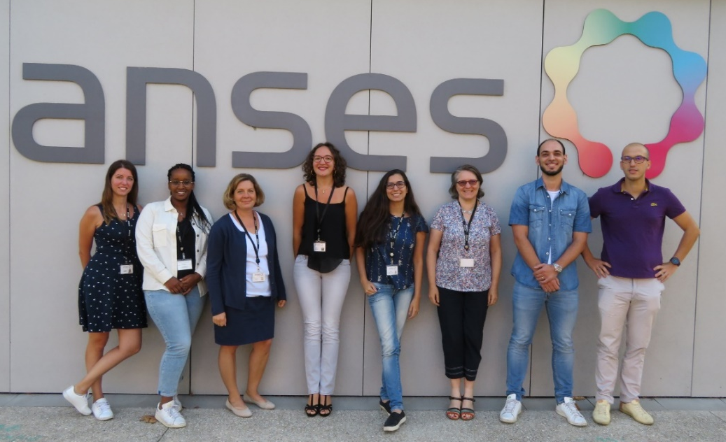
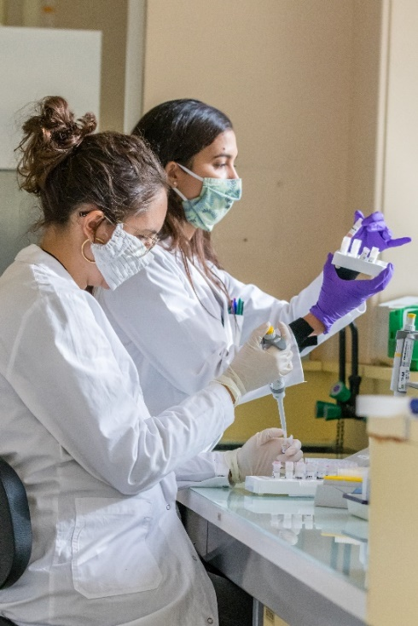
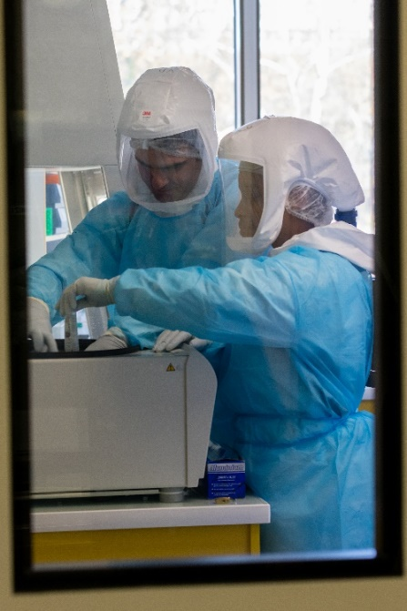
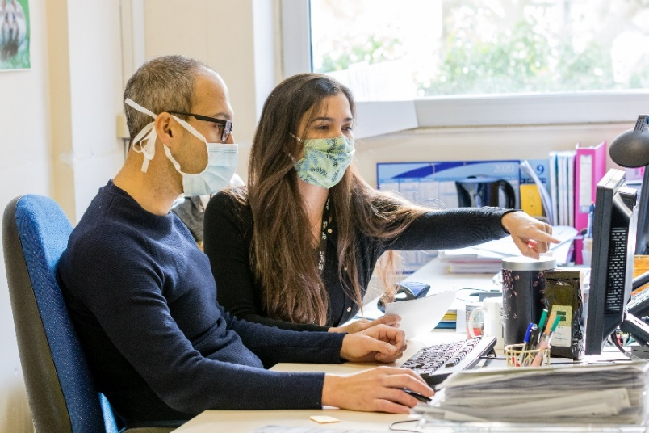
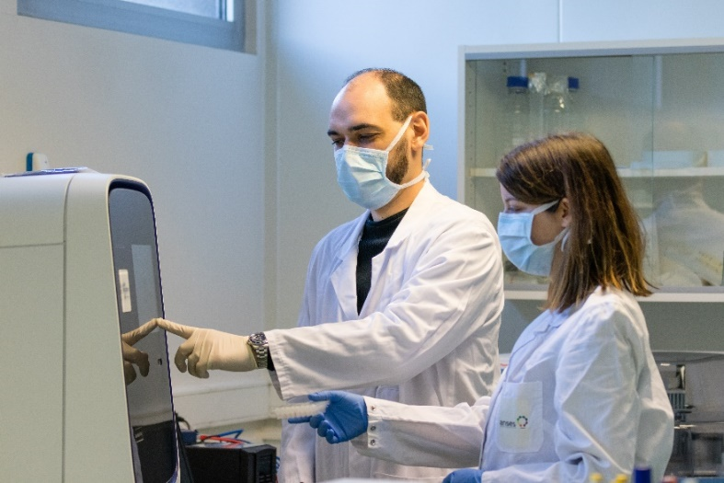
Thank you for your attention

